Slide 1
Analyzing Obesity Statistics
Sarah Ramirez, Jordan Sam, Laiba Hasan, Rohan Behera, Alex Szeto

Slide 2

Our Dataset
FAVC | Frequent consumption of high caloric food (yes or no)
FCVC | Frequency of consumption of vegetables (measured in 3 intervals: never, sometimes, always)
NCP | Number of main meals eaten per day (measured in 3 intervals: between 1 and 2, 3, more than 3)
CAEC | Consumption of food between meals (measured in 4 intervals: no, sometimes, frequently, always)
SMOKE | If the participant smokes (yes or no)
CH20 | Consumption of water daily (measured in 3 intervals: less than 1 liter, between 1 and 2L, more than 2L)
CALC | Consumption of alcohol (measured in 3 intervals: no, sometimes, frequently)
SCC | Calories consumption monitoring (yes or no)
FAF | Physical activity frequency (measured in 4 intervals: none, 1-2 days, 2-4 days, 4-5 days)
TUE | Time using technology devices (measured in 3 intervals: 0-2 hours, 3-5 hours, more than 5 hours)
MTRANS | Transportation used (automobile, motorbike, bike, public transportation, walking)
NObeyesdad | Obesity level (insufficient, normal weight, overweight level I, overweight level II, obesity type I, obesity type II, obesity type III)

Slide 3
Data Cleaning
Rounded values to the nearest whole number & decimal place
Age
Height
Weight
Binned water consumption into ranges
Below normal
Normal
Above normal
Binned physical activity into ranges
Less than average
Average
above average
Binned number of main meals into ranges
Less than 3 meals
3 or more meals

Slide 4
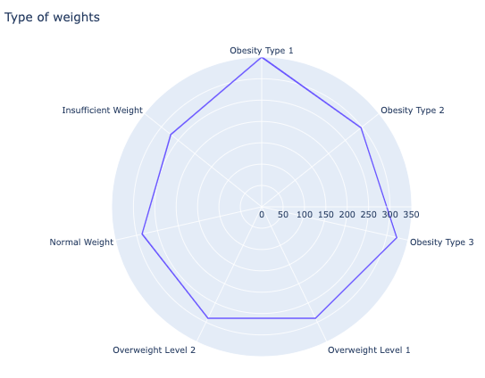
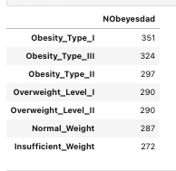
EDA
01
Spider Chart

Slide 5
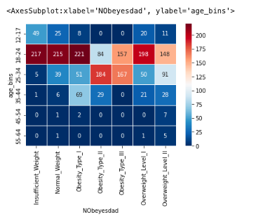
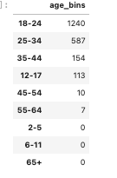
EDA
02
HeatMap

Slide 6
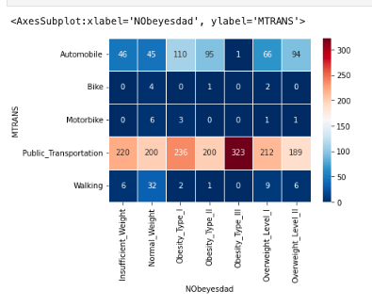
EDA
03
HeatMap

Slide 7
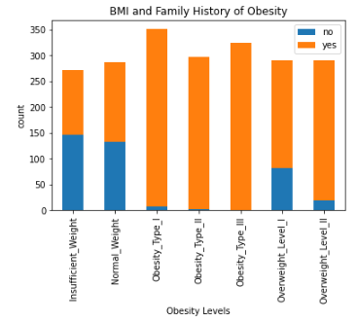
EDA
04
Stacked bar
chart

Slide 8
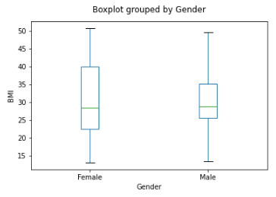
EDA
05
Box plot

Slide 9

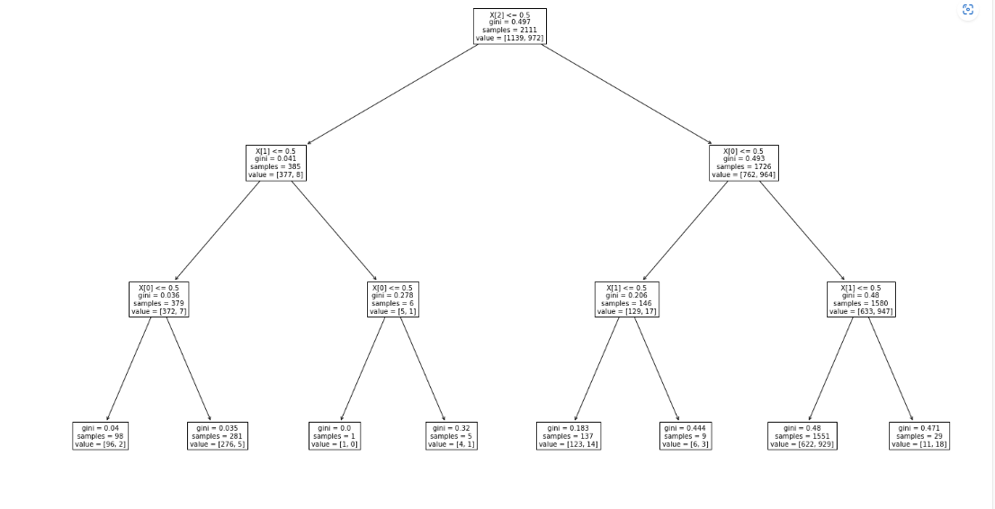
Decision Trees
A supervised machine learning model that allows you to make decisions based on previous ones
It can only be used with numerical data
X[height] <= 0.5 indicates that every user with a rank of 0.5 or lower follows the True arrow on the left, if not they follow the False arrow on the right
Gini refers to quality of the split
Equation used for Gini: 1 - (x/n)^2 + (y/n)^2
Source: Python Machine Learning Decision Tree (w3schools.com)

Slide 10
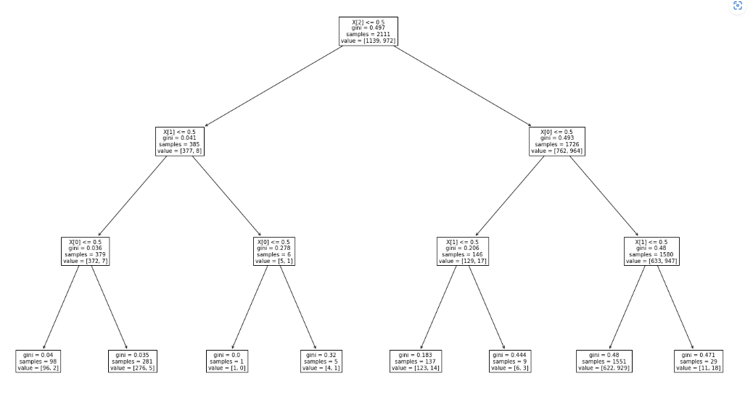
Decision Trees(cont.)
Here, we are looking at a decision tree predicting obese or not obese
The features we are using are:
Smoking
High calorie food consumption
Family overweight history
Notes:
Alright so based off of the information rohan gave us, we are going to take a look at this decision tree predicting obese or not obese further. Since some of the data were not yes or no questions we had to bin them in order to make the decision tree less complex.
Here, our features are smoking, high caloric food consumption, and family overweight history.
In our program, we put in the values 0 or 1, where 0 means no the do not smoke and 1 means yes they do smoke.
we binned accordingly for our features.

Slide 11
Notes:
As we can see by the decision tree, going all the way left represents an input of 0,0,0 into our prediction. In other words, we are predicting if someone is obese or not obese based off of not smoking, not frequently consuming high caloric fast food, and the person does not have overweight family history. Based off that information, 11 people are classified as obese and 18 are classified as not obese.
For a sample of 1551 people who said they don't smoke, frequently consume high caloric fast food, and have overweight family history, 622 people are classified as obese and 929 people are classified as not obese.
For a sample of 9 people who said they don’t smoke, they do consume high calorie food frequently and don’t have overweight family history, 6 people are obese and 3 people are not obese.

Slide 12
Question #1
In our decision tree sample of 29 people, how many of them were found to be obese and not obese?

Slide 13
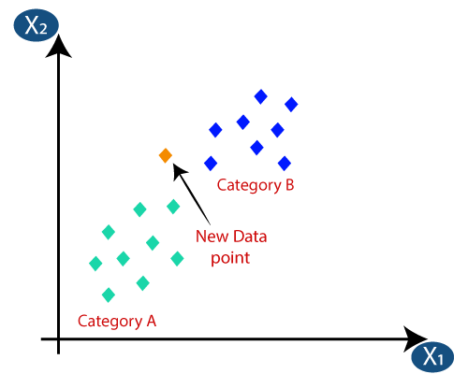
K-Nearest-Neighbors
What is KNN?
KNN is a supervised learning model.
It uses proximity to classify a data point to the appropriate grouping.
In our project, we used KNN to classify a person to their respective obesity level based off of their responses.

Slide 14

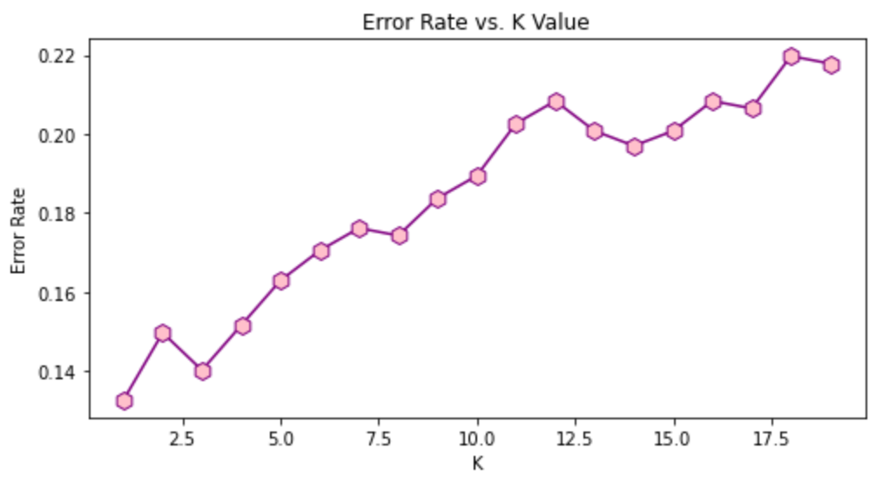
Elbow Method
Not that
elbow ->
Shows us which k is the optimal k
The K with the least error rate is the k we want
We choose k = 3 here

Slide 15
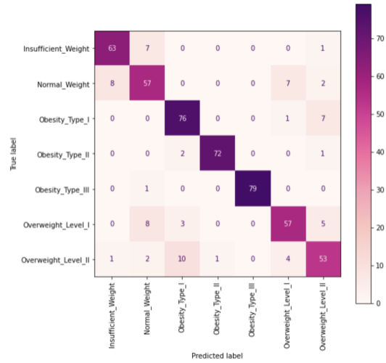
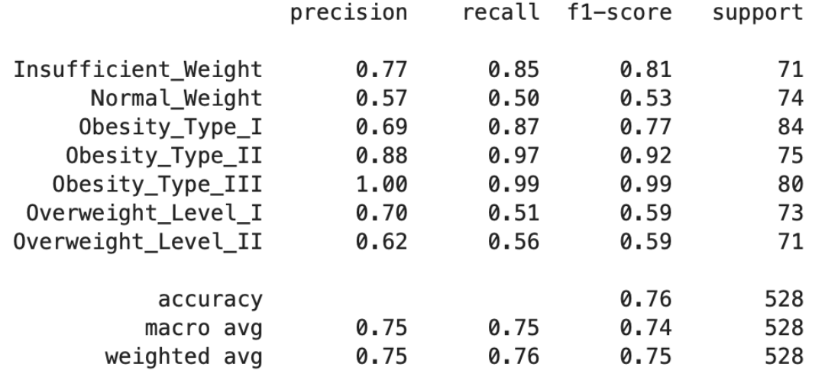
Confusion Matrix
Diagonal line represents true positive values
Tells us how many values were predicted correctly

Slide 16
Question #2
Does our confusion matrix indicate our model has good performance? How can you tell?

Slide 17
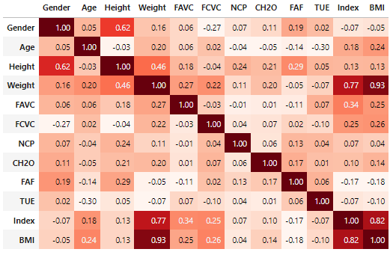
Correlation Matrix
Darker means higher correlation
BMI is important

Slide 18
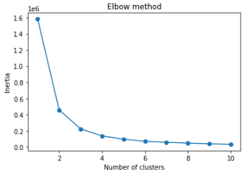
K-means Elbow Method
Looked at BMI and weight
k=3
Elbow

Slide 19
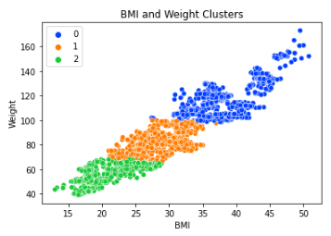
K-means Clustering
Unsupervised learning
Labeling data

Slide 20
Question #3
What technique did we use for finding the optimal k for k-means clustering?
Notes:
Put this after K Means Clustering slides

Slide 21
THANKS FOR
WATCHING!
Notes:
LIKE AND SUBSCRIBE

